Slide 1


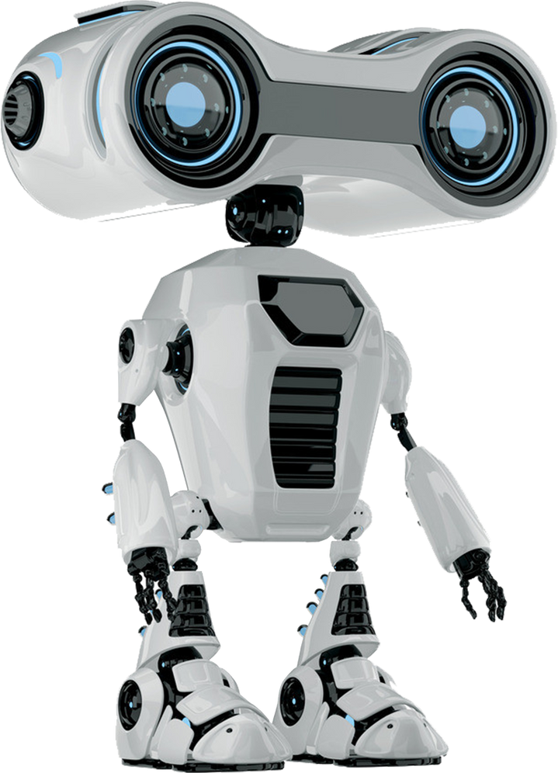
Deep Learning-Based Classification of Skin Diseases and Cancer
Group 5:
Loh Chia Heung (Leader) 2301684
Tan Yi Xin 2101990
Bester Loo Man Ting 2207066
Cornelius Wong Qin Jun 2104603
Google Drive Link: https://drive.google.com/file/d/1ZUhHImmvhZEpG5P0YAV4xemHto_KAB46/view?usp=sharing
Notes:
Google Drive Link: https://drive.google.com/file/d/1ZUhHImmvhZEpG5P0YAV4xemHto_KAB46/view?usp=sharing

Slide 2

Introduction
Early detection of melanoma = critical for survival.
Current diagnostic process: subjective, depends on the dermatologist’s expertise.
Project goal: Develop an automated system to classify 7 skin lesion categories using deep learning.
Focus: Achieve high diagnostic accuracy, especially for malignant lesions (Melanoma, BCC).
Presented by: Tan Yi Xin (2101990)

Slide 3

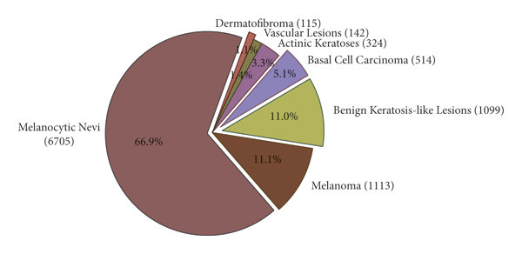
Project Scope & Objectives
Dataset: HAM10000 [1] – a large dermatoscopic image dataset.
The core challenge: Severe Class Imbalance
Our Approach: Build an end-to-end ML pipeline, evaluate & Fine-tune 4 architectures (EfficientNet-B0, DenseNet-121, Inception V3, Swin Transformer), and prepare models for clinical application.
Primary Objective: To build, train, and compare these models to find the most effective solution for this real-world problem.
[1] P. Tschandl, C. Rosendahl, and H. Kittler, "The HAM10000 dataset, a large collection of multi-source dermatoscopic images of common pigmented skin lesions," Sci. Data, vol. 5, no. 1, p. 180161, 2018.
Presented by: Tan Yi Xin (2101990)

Slide 4
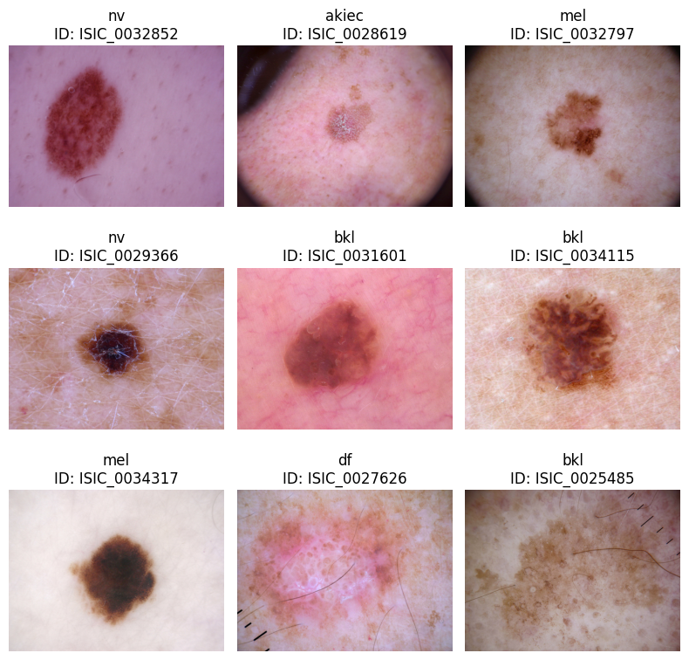
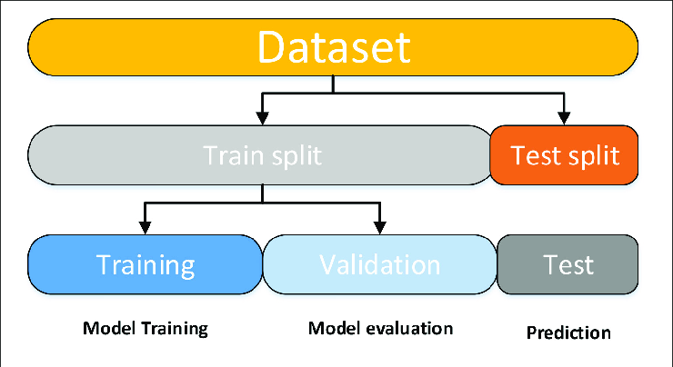
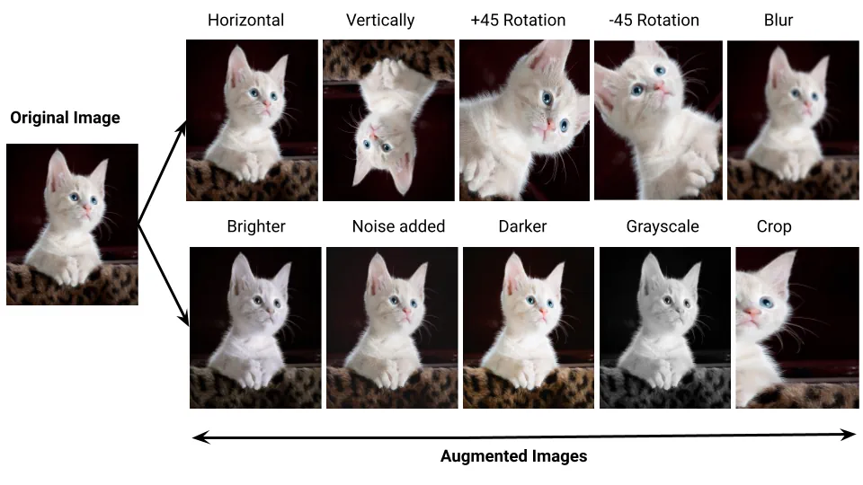

Data Preparation, Preprocessing
Missing Data Handling – Imputation
Data Labeling - Maps 7 lesion
Image Path Resolving – match image files with entries
Data Splitting - perform [6:2:2] splits of [training : Validation : Test]
Image Augmentation –Resize, Flips , Rotate, Color jitter, Normalization (Train), Resize, Normalize (Test)
Custom Dataset – Data loaders of images and apply transformation
Weighted Sampling – training data loader using WeightedRandomSampler
Presented by Bester Loo Man Ting (2207066)

Slide 5

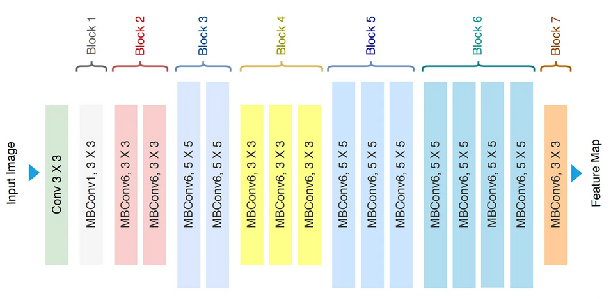
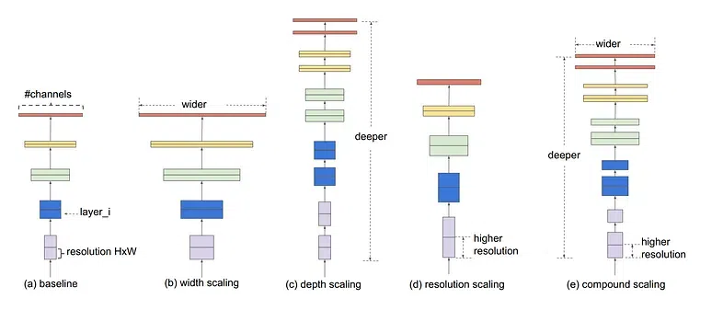
Related Work- EfficientNet-B0
EfficientNet-B0: Optimizing Accuracy vs. Efficiency
Challenge: Earlier CNNs → larger & deeper networks → high computation cost.
EfficientNet-B0 introduces Compound Scaling [8]:
Balances depth, width, and input resolution together.
More principled scaling vs. brute-force network enlargement.
Built on neural architecture search → efficient by design.
Achieves state-of-the-art accuracy with fewer parameters & FLOPs.
Significance: Ideal for real-world medical applications, where hardware resources are limited (e.g., hospital devices, mobile tools) [9].
[8] M. Tan and Q. V. Le, "EfficientNet: Rethinking Model Scaling for Convolutional Neural Networks," in International Conference on Machine Learning (ICML), 2019, pp. 6105–6114
[9] Abayomi-Alli, O., Damaševičius, R., Maskeliūnas, R., & Abayomi-Alli, A. (2021). "An Ensemble of Deep Learning-Based Models for Automatic Skin-Lesion Classification.“ Electronics, 10(23), 3020
Presented by: Tan Yi Xin (2101990)

Slide 6
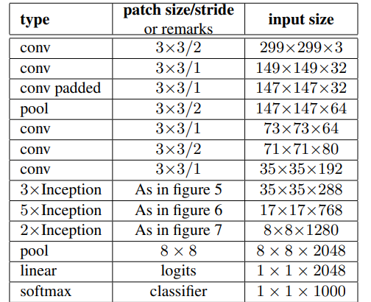
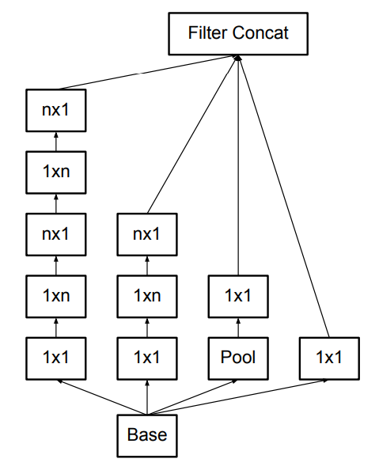
Related Work- Inception-v3
Inception_v3: Optimizing Efficiency
Goal: To achieve high accuracy in image classification while remaining computationally efficient.
PROBLEMS ADDRESSED : High Computational Cost & Overfitting
KEY INNOVATIONS:
1) Efficiency: Asymmetric Convolutions
Method: Decomposes a large n x n convolution into a 1 x n followed by an n x 1 convolution
Benefit: 33% cheaper, Reduces computation without sacrificing the ability to learn spatial features.
2) Mitigating Overfitting: Regularization
Auxiliary Classifiers: Act as regularizers by adding their loss to the main loss function, improving generalization.
Label Smoothing (LSR): Prevents the model from becoming overconfident by distributing a small amount of probability across all labels.
WEAKNESS: input Image Size: 299 which extra heavy then normal 224
C. Szegedy, V. Vanhoucke, S. Ioffe, J. Shlens, and Z. Wojna, “Rethinking the inception architecture for computer vision,” arXiv.org, https://arxiv.org/abs/1512.00567 (accessed Sep. 7, 2025).
Presented by: Cornelius Wong Qin Jun (2104603)

Slide 7
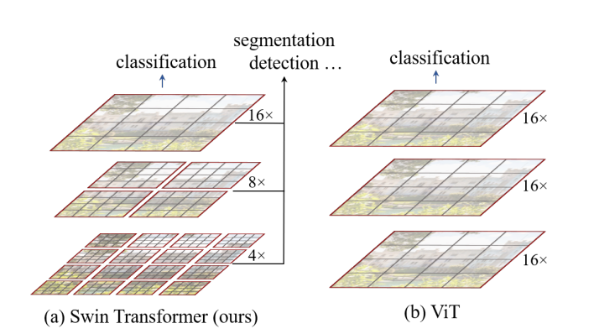
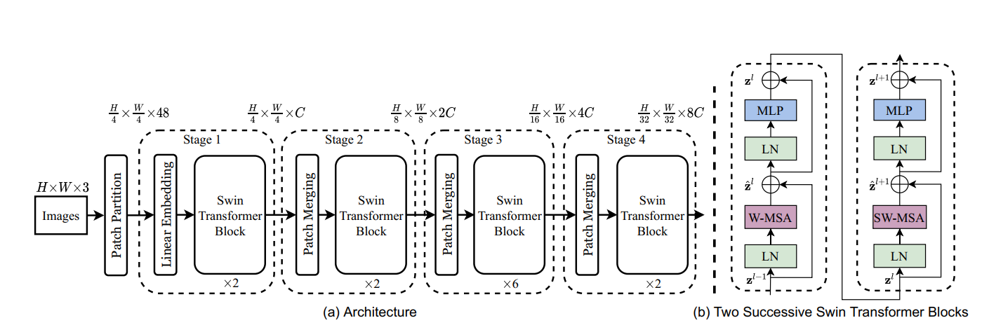
Related Work – Swin Transformer
Improvement over ViT (Vision Transformer)
Shifted window attention → efficient, captures local + global features
Hierarchical structure (like CNNs) → multi-scale feature extraction
Cross-window connections → better global representation
Linear complexity → scales well to high-resolution images
Effective for medical images (lesions vary in size, shape, texture)
Pacal et al. (2023): 89.36% accuracy on 8-class skin cancer dataset → outperformed CNN & ViT
Conclusion: Suitable for HAM10000 7-class lesion classification
Z. Liu et al., "Swin Transformer: Hierarchical Vision Transformer using Shifted Windows," 2021 IEEE/CVF International Conference on Computer Vision (ICCV), Montreal, QC, Canada, 2021, pp. 9992-10002, doi: 10.1109/ICCV48922.2021.00986.
Presented by: Loh Chia Heung (2301684)
Notes:
Reference Used:
[11] Z. Liu et al., "Swin Transformer: Hierarchical Vision Transformer using Shifted
Windows," 2021 IEEE/CVF International Conference on Computer Vision (ICCV), Montreal,
QC, Canada, 2021, pp. 9992-10002, doi: 10.1109/ICCV48922.2021.00986.
[12] Pacal, I., Alaftekin, M. & Zengul, F.D. Enhancing Skin Cancer Diagnosis Using Swin Transformer with Hybrid Shifted Window-Based Multi-head Self-attention and SwiGLUBased MLP. J Digit Imaging. Inform. med. 37, 3174–3192 (2024). https://doi.org/10.1007/s10278-024-01140-8

Slide 8
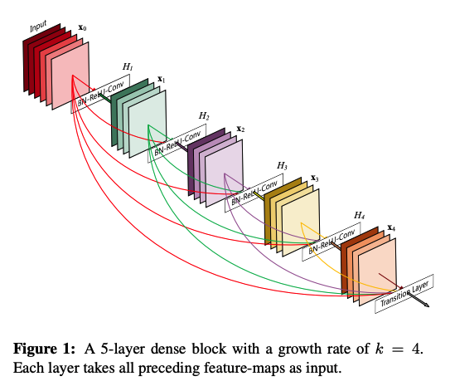
Related Work – DenseNet-121
DENSELY CONNECTED CONVOLUTIONAL NETWORKS
Overview & Architecture
Core Concept and Innovations
Introduce ”Dense Blocks” - Concatenate feature maps from all previous layer until classification
Mitigation vanishing gradient problem – direct access network, minimal degrade
Encourage feature reuse – preserve early layers
Reduced parameters (Contrast to ResNet) –redundant relearning avoided
Variants
Differ based on number of convolutional layers in each dense block
DenseNet-121: [6, 12, 24, 16]
DenseNet-169: [6, 12, 32 , 32] etc
[Zarea & Pourkazemi, 2021]
U-Net + DenseNet-121, (ISIC-2018, HAM10000)
Accuracy: 93.11% (Non-Cancerous), 79.49% (Cancerous)
[Eliwa, 2025]
Two-Phase learning (HAM10000), DensetNet-121
Accuracy: 85.82% (Pre-trained), 96.95 (fine-tuned)
G. Huang, Z. Liu, L. Van Der Maaten, and K. Q. Weinberger, “Densely Connected Convolutional Networks,” in 2017 IEEE Conference on Computer Vision and Pattern Recognition (CVPR), Honolulu, HI, USA, Jul. 2017, pp. 2261–2269. doi: 10.1109/CVPR.2017.243.
Presented by Bester Loo Man Ting (2207066)
Notes:
Because each layer has access to all previously learned features, there is no need to re-learn redundant feature maps.

Slide 9
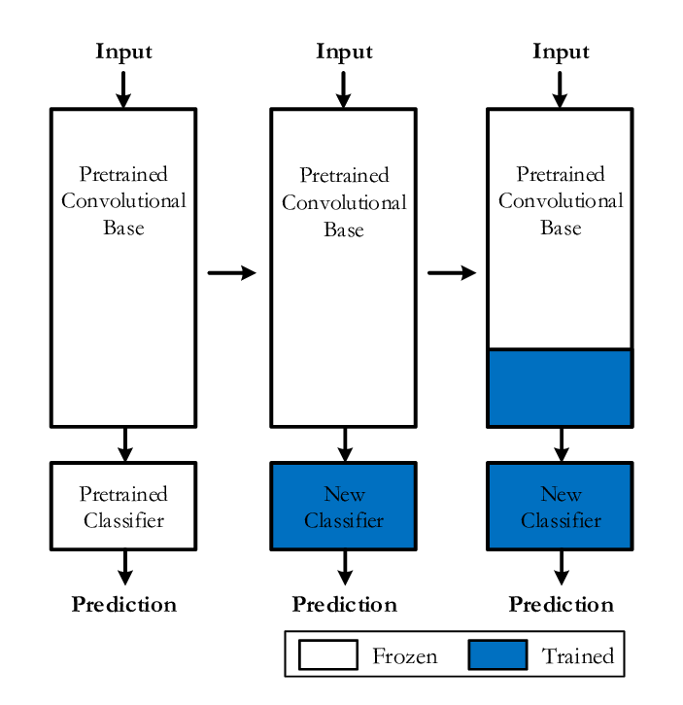
Model Initialization
Model selection
EfficientNet-B0
Swin Transformer
DensetNet121
InceptionV3
Model Learning strategy:
Initialize_model: using pretrained weight from ImageNet
Linear layer replacement: final layer of each model is replaced with Linear layer (7 classes of skin lesions)
Feature Extraction[1] & Fine tune control[2]
[1] by freezing backbone layers
[2] by selectively unfreeze layers
Inception-V3 Flexible freezing strategies
”last” unfreeze last block
”last3” unfreeze last 3 blocks
”full” unfreeze all layers
Presented by Bester Loo Man Ting (2207066)

Slide 10
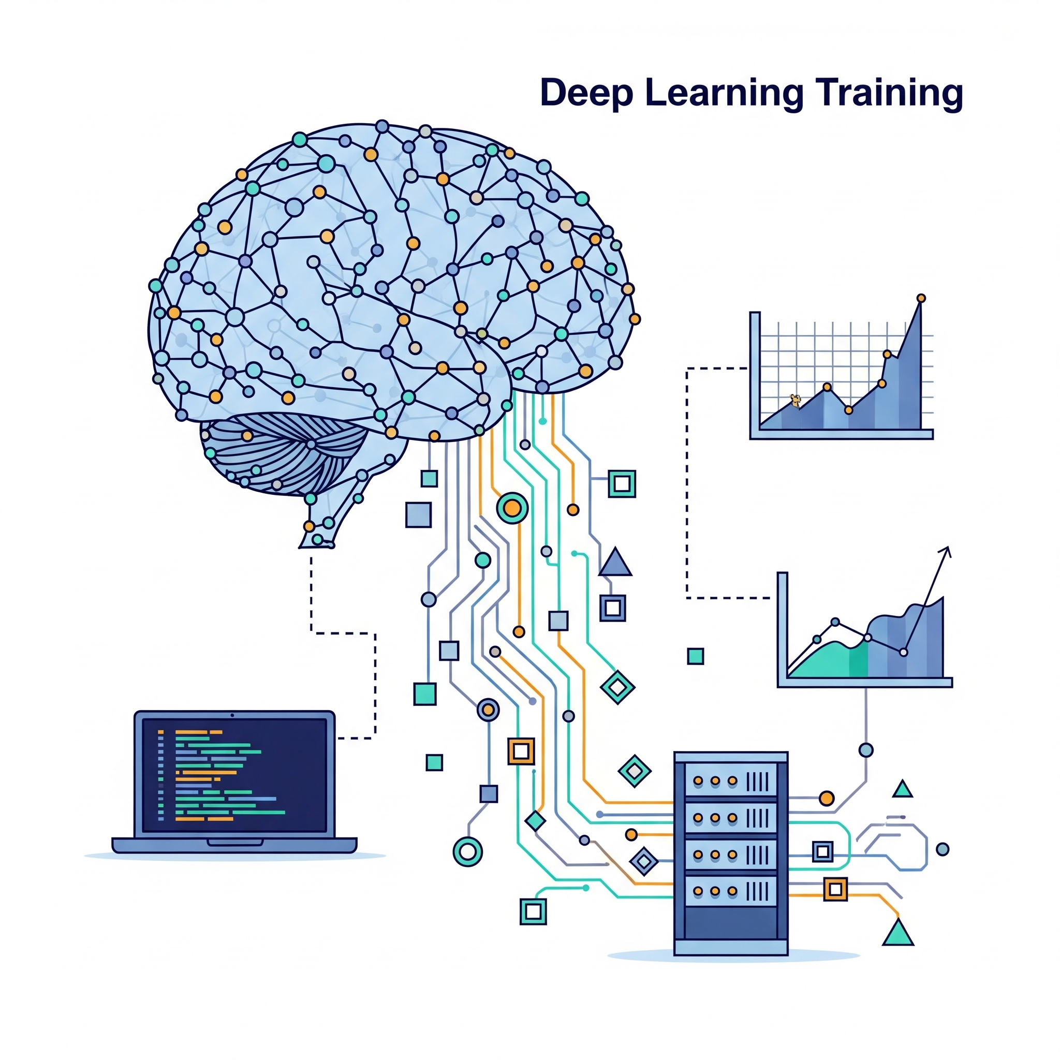
Training
1. Core Components
Optimizer: AdamW
(LR: 1e-4, Weight Decay: 1e-5).
Loss Function: CrossEntropyLoss for multi-class classification.
Scheduler: ReduceLROnPlateau to adapt the learning rate if validation loss stagnates.
InceptionV3 Differential Learning:
Backbone: 1e-4 (Fine-tuning).
Head: 1e-3 (Faster learning for new layers).
2. Training & Validation Cycle
Each epoch consists of a training step and a validation step.
Training: The model trains on data batches using the GPU.
InceptionV3 Specifics: Uses Automatic Mixed Precision (AMP) for speed and calculates an auxiliary loss (Total Loss = Main Loss + 0.4 * Aux Loss) for regularization.
Validation: The model's performance is measured on unseen data without updating its weights.
3. Efficiency & Control
Early Stopping: Training is automatically halted if the validation loss does not improve for 10 consecutive epochs.
The best-performing model state is saved for final evaluation.
Presented by Cornelius Wong Qin Jun (2104603)

Slide 11
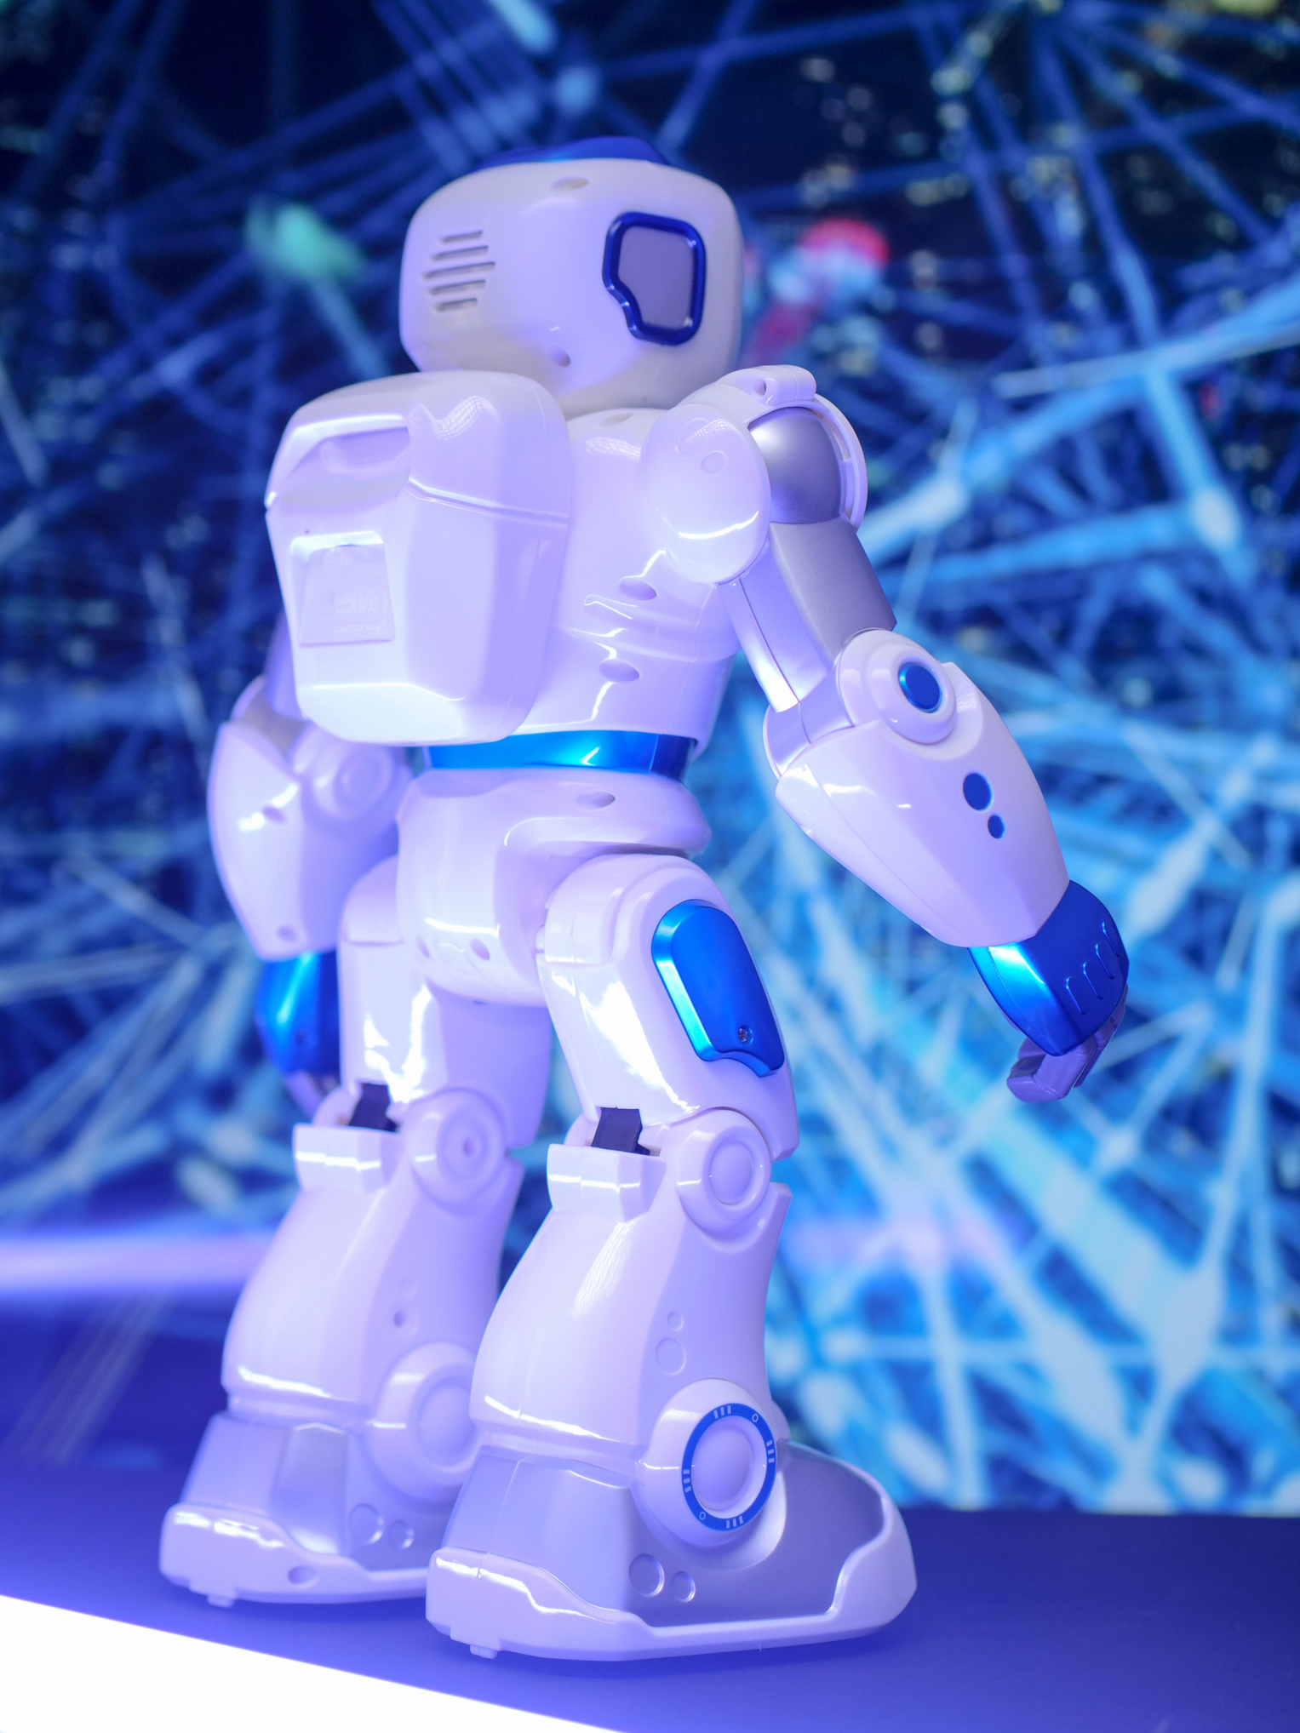
Experimental Setup
1. Dataset | HAM 10000 (7 classes)
2. Preprocessing | 224 x 224 299 x 299 (InceptionV3) Normalization Data Augmentation
3. Imbalance Handling | WeightedRandomSampler
4. Training | PyTorch AdamW (lr = 0.0001) ReduceLROnPlateau EarlyStopping
5. Evaluation Metrics | Accuracy Macro F1 Weighted F1 Confusion Matrix
Presented by: Loh Chia Heung (2301684)

Slide 12
vasc: Vascular
nv: nevus
mel: Melanoma
df: Dermatofibroma
Experimental Result
Model | Accuracy (%) | Macro F1 | Weighted F1 | Best Class (F1) | Weakest Class (F1)
EfficientNet-B0 | 84.5 | 0.780 | 0.850 | df (0.84) | mel (0.61)
DenseNet121 | 86.5 | 0.812 | 0.867 | df (0.90) | mel (0.64)
Swin Transformer | 88.9 | 0.834 | 0.890 | vasc (0.95) | mel (0.67)
InceptionV3 | 77.3 | 0.675 | 0.782 | nv (0.88) | mel (0.54)
Best Model: Swin Transformer
Weakest Class: Melanoma (mel)
Presented by: Loh Chia Heung (2301684)

Slide 13

Comparative Discussion
CNNs: DenseNet121 > EfficientNet-B0 ; InceptionV3 weakest
Transformer (Swin): Outperformed CNNs → captures long-range dependencies.
Trade-off: Swin = higher accuracy, but greater computational cost
Practical note: DenseNet/EfficientNet suitable for resource-limited settings; Swin better for clinical use
Melanoma challenge: Consistently weakest class (F1: 0.54–0.67) due to imbalance & similarity with nevus
vasc: Vascular
nv: nevus
mel: Melanoma
df: Dermatofibroma
Presented by: Loh Chia Heung (2301684)

Slide 14

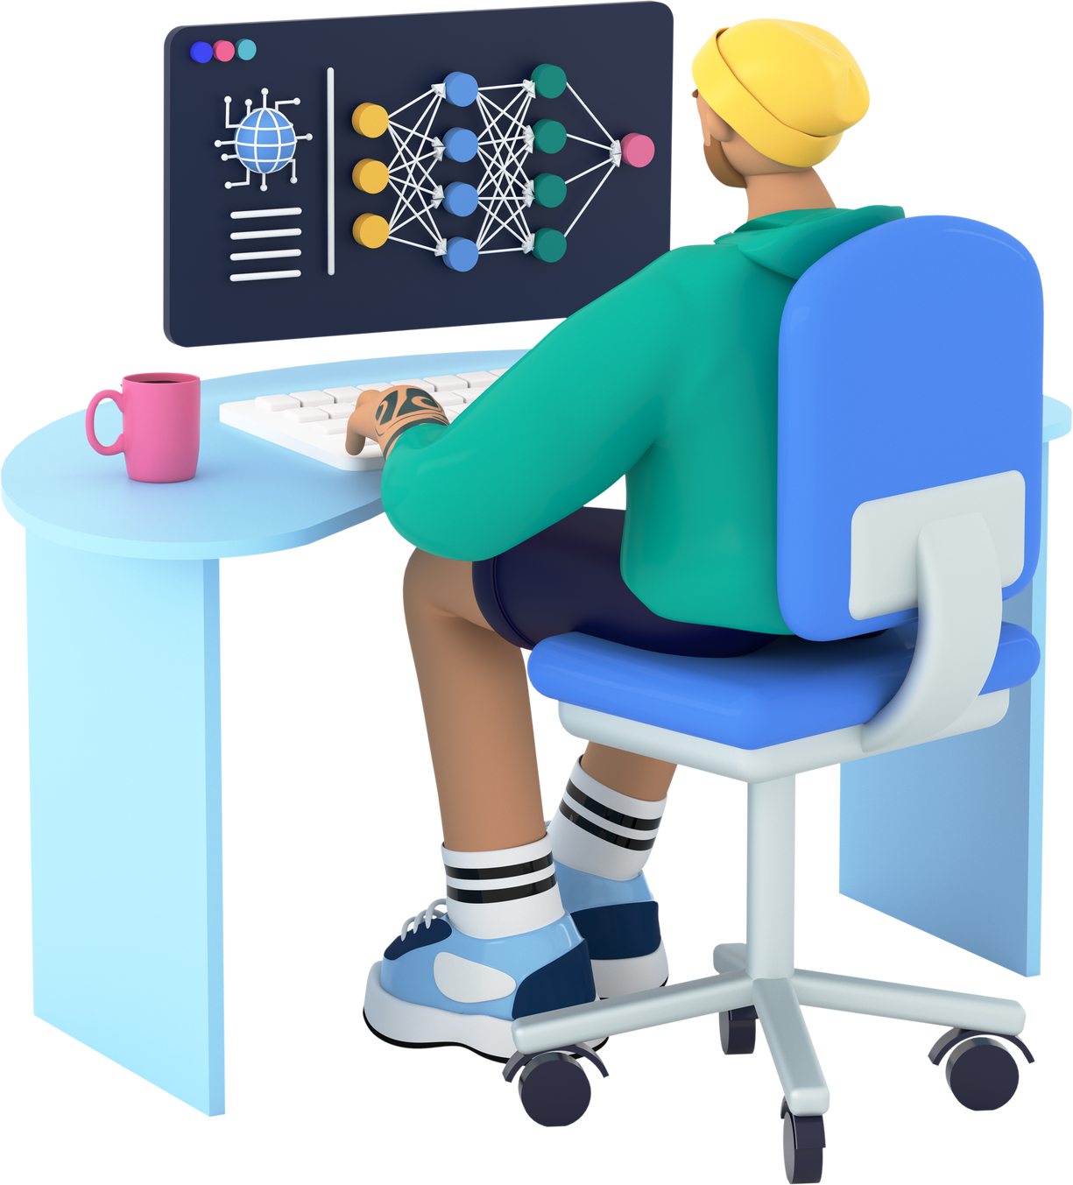
Conclusion
Automated classification of pigmented skin lesions supports dermatologists with a reliable “second opinion.”
Addressed class imbalance and benchmarked 4 modern deep learning architectures.
Swin-T stands out with a strong efficiency–accuracy tradeoff → practical for deployment.
Future potential: Clinical integration, real-time diagnosis, and support for teledermatology.
Contribution: A step toward reducing misdiagnosis, enabling faster treatment decisions, and improving patient outcomes.
Presented by Cornelius Wong Qin Jun (2104603)

Slide 15
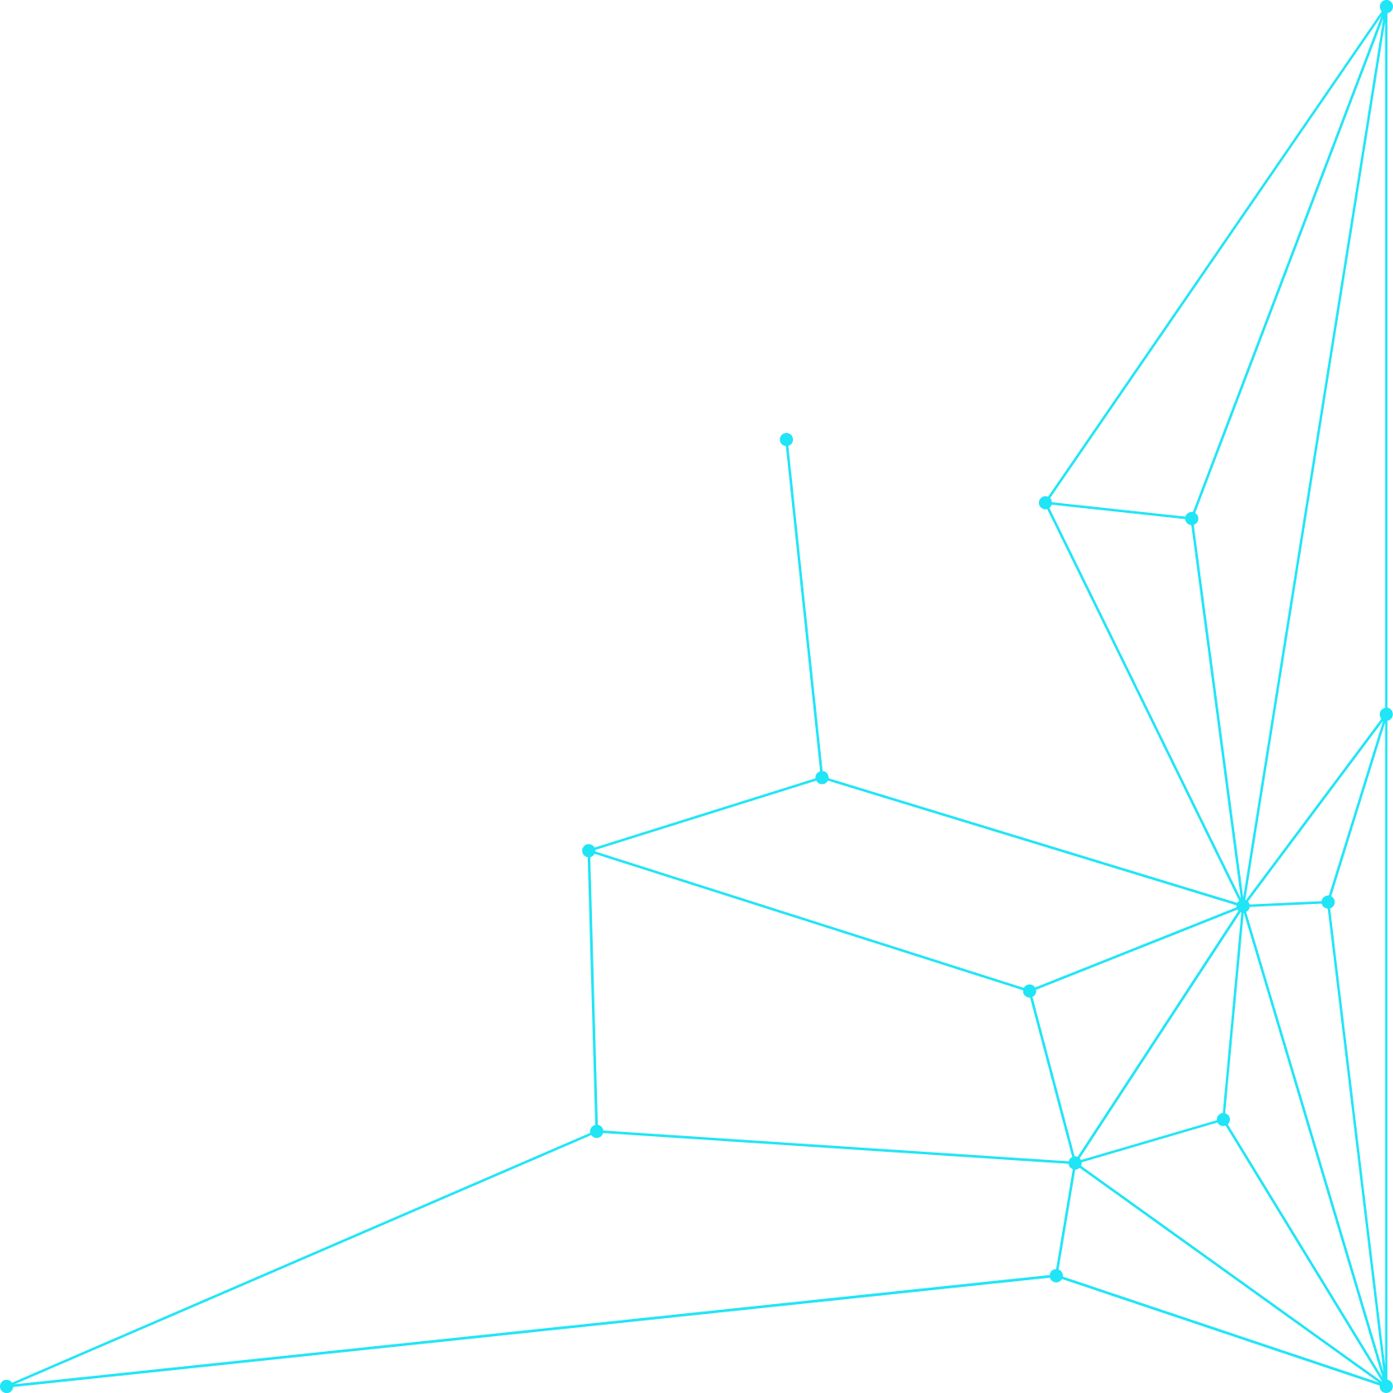

Thank You!
- Proceed to System Demonstration -

